Slide 1
Computer Organization & Design —The Hardware/Software Interface
Chapter 4-2 Processor Design

Slide 2
Multicycle Approach
We will be reusing functional units
ALU used to compute address and to increment PC
Memory used for instruction and data
We will use a finite state machine for control

Slide 3
Multi-cycle CPU datapath

Slide 4
Multicycle Approach
Break up the instructions into steps, each step takes a cycle
balance the amount of work to be done
restrict each cycle to use only one major functional unit
At the end of a cycle
store values for use in later cycles
introduce additional internal registers

Slide 5
Review
Instruction class | Instruction memory | Register read | ALU | Data memory | Register write | Total
R-format | 2 | 1 | 2 |  | 1 | 6 ns
Load word | 2 | 1 | 2 | 2 | 1 | 8 ns
Store word | 2 | 1 | 2 | 2 |  | 7 ns
Branch | 2 | 1 | 2 |  |  | 5 ns
Jump | 2 |  |  |  |  | 2 ns
I-Memory and D-Memory are used in different stage.
PC+4, PC+4+imm<<2, ALU operation are calculated in different stages.
So memory and ALU can be shared in different stages.

Slide 6
Multicycle Approach
a Multicycle datapath
shared unit

Slide 7
How to use one memory to implement Inst. fetch and data access?
IorD
WriteMem
ReadMem
WriteIR
ALUout
MUX
Address
Data out
Data
PC
PC
PC
IR
DR
B
WriteDR
Instruction fetch
Can load data from memory
Can store data to Memory

Slide 8
How to implement Adders and ALU ops using one ALU
PC
A
A
A
ALU
ALUout
B
B
4
B
16 imm
Sign Ext
<<2
Operation
Can also do A+imm
(ALU-R-I)operation
Mem Address calculation
Can also do
PC + 4 + imm<<2
Only ALU operation
Can do PC+4 too

Slide 9
Data path in detail

Slide 10
How does it control in Multicycle Approach

Slide 11
Control signals
name | Effect when deasserted(=0) | Effect when asserted(=1)
RegDst | Select register destination number from the rt(20:16) when WR. | Select register destination number from the rd(15:11) when WB.
RegWrite | None | Register destination input is written with the value on the Write data input
ALUScrA | The first ALU operand is the PC | The first ALU operand come from the A register.
MemRead | None | Memory contents at the location specified by the address input is put on the Memory data out.
MemWrite | None | Memory contents at the location specified by the address input are replaced by value on the Write data input.
MemtoReg | The value fed to register Write data input comes from the ALUOut | The value fed to the register Write data input comes from the MDA.
IorD | The PC is used to supply the address to the memory unit. | ALUOut is used to supply the address to the memory unit.
IRWrite | None | The output of memory is written into the IR.
PCWrite | None | The is written;the source is controlled by PCSource.
PCWriteCond | None | The PC is written if the zero output from the ALU is also active.

Slide 12
Control signals
Signal name | Value | Effect
ALUOp | 00 | The ALU performs an add operation.
 | 01 | The ALU performs an subtract operation.
 | 10 | The funct field of the instruction determines the ALUoperation
ALUScrB | 00 | The second input to the ALU comes from the B register.
 | 01 | The second input to the ALU is the constant 4.
 | 10 | The second input to the ALU is the sign-extended, lower 16 bits of the IR.
 | 11 | The second input to the ALU is the sign-extended, lower 16 bits of the IR shift 2 bits.
PCSource | 00 | Output of the ALU(PC+4) is sent to the PC for writing.
 | 01 | The contents of ALUOut (the branch target address) are sent to the PC writing.
 | 10 | The jump target address (IR[25:0]shifted left 2 bits and concatenated with PC+4[31:28]) is sent to the PC for writing.

Slide 13
PC 的改变方式
seq: pc = pc + 4
beq： pc = pc + offset * 4
j ： pc = pc₃₁₋₂₈ ## IR₂₅₋₀ << 2

Slide 14
seq: pc = pc + 4
beq：pc = pc + offset * 4
j ：pc = pc₃₁₋₂₈ + IR₂₅₋₀ << 2

Slide 15
Five Execution Steps
IF: Instruction Fetch
ID: Instruction Decode and Read Register
EX: Execution, Memory Address Computation, or Branch Completion
DM: Memory Access or R-type instruction completion
WB: Write-back step INSTRUCTIONS TAKE FROM 3 - 5 CYCLES!

Slide 16
Step 1: Instruction Fetch
Use PC to get instruction and put it in the Instruction Register.
IR ⬅ Memory[PC];
Increment the PC by 4 and put the result back in the PC.
PC ⬅ PC + 4;
Can be described simply using RTL "Register-Transfer Language" IR = Memory[PC]; PC = PC + 4;
Can we figure out the values of the control signals?
What is the advantage of updating the PC now?

Slide 17
Step 2: Instruction Decode and Register Fetch
Read registers rs and rt in case we need them
Compute the branch address in case the instruction is a branch
RTL: A = Reg[IR[25-21]]; B = Reg[IR[20-16]]; ALUOut = PC+sign-extend(IR[15-0])<< 2);
We aren't setting any control lines based on the instruction type (we are busy "decoding" it in our control logic)

Slide 18
Step 3 (instruction dependent)
ALU is performing one of three functions, based on instruction type
Memory Reference ( lw / sw ): ALUOut = A + sign-extend(IR[15-0]);
R-type: ALUOut = A op B;
Branch: if (A==B) PC = ALUOut;
jump:
pc = pc[31-28]&& IR[25-0]<<2

Slide 19
Step 4 (R-type or memory-access)
Loads and stores access memory MDR = Memory[ALUOut]; # for lw
or Memory[ALUOut] = B; # for sw
R-type instructions finish Reg[rd]=Reg[ IR[15-11] ] = ALUOut; The write actually takes place at the end of the cycle on the edge

Slide 20
Write-back step (step 5)
lw
Reg[rt]=Reg[IR[20-16]]= MDR;
What about all the other instructions?

Slide 21
Summary

Slide 22
Simple Questions
How many cycles will it take to execute this code? (21) lw $t2, 0($t3) lw $t3, 4($t3) beq $t2, $t3, Label #assume not add $t5, $t2, $t3 sw $t5, 8($t3) Label: ...
What is going on during the 8th cycle of execution?
In what cycle does the actual addition of $t2 and $t3 takes place?
Answer: Calculating memory address
Answer: No.16

Slide 23
Implementing the Control
Value of control signals is dependent upon:
what instruction is being executed
which step is being performed
Let’s go over the main control unit in the single-cycle implementation.

Slide 24
Review – Control unit
Main control unit in the single-cycle implementation
R-type 0
lw 35
sw 43
beq 4

Slide 25
Review – ALU controller
Now,let’s look at the AlU control unit. It does not need to changed.

Slide 26
As same as the single-cycle
So,the following truth table remains the same.

Slide 27
Difference in controller
Do something different in each cycle
Two main ways to implement the control
1. Finite state machine
2. use microprogramming
Next,we will discuss the first way.

Slide 29
Review: Finite state machines
Finite state machines:
a set of states
next state function (determined by current state and the input)
output function (determined by current state and possibly input)

Slide 30
Instruction execute flow
Ref Fig5.31 (中文版p.216)
Start
Instruction fetch/decode and registerfetch
Figure(5.32)
Menory access
instructions
Figure(5.33)
R-type instructions
Figure(5.34)
Branch instructions
Figure(5.35)
Jump instructions
Figure(5.36)

Slide 31
Instruction fetch / decode and Read Reg
I
n
s
t
r
u
c
t
i
o
n
d
e
c
o
d
e
/
I
n
s
t
r
u
c
t
i
o
n
f
e
t
c
h
R
e
g
i
s
t
e
r
f
e
t
c
h
0
M
e
m
R
e
a
d
1
A
L
U
S
r
c
A
=
0
I
o
r
D
=
0
A
L
U
S
r
c
A
=
0
I
R
W
r
i
t
e
S
t
a
r
t
A
L
U
S
r
c
B
=
0
1
A
L
U
S
r
c
B
=
1
1
A
L
U
O
p
=
0
0
A
L
U
O
p
=
0
0
P
C
W
r
i
t
e
P
C
S
o
u
r
c
e
=
0
0
p
e
)
'
)
)
t
y
Q
'
=
R
-
B
E
P
O
p
'
M
(
=
J
S
W
'
)
p
'
p
=
'
O
=
o
r
(
O
(
p
W
'
)
O
p
=
'
L
(
(
O
M
e
m
o
r
y
r
e
f
e
r
e
n
c
e
F
S
M
R
-
t
y
p
e
F
S
M
B
r
a
n
c
h
F
S
M
J
u
m
p
F
S
M
(
F
i
g
u
r
e
5
.
3
3
)
(
F
i
g
u
r
e
5
.
3
4
)
(
F
i
g
u
r
e
5
.
3
5
)
(
F
i
g
u
r
e
5
.
3
6
)

Slide 32
F
r
o
m
s
t
a
t
e
1
(
O
p
=
'
L
W
'
)
o
r
(
O
p
=
'
S
W
'
)
M
e
m
o
r
y
a
d
d
r
e
s
s
c
o
m
p
u
t
a
t
i
o
n
2
A
L
U
S
r
c
A
=
1
A
L
U
S
r
c
B
=
1
0
A
L
U
O
p
=
0
0
)
(
O
'
p
W
=
L
'
'
S
=
W
lw and sw
p
'
)
O
M
e
m
o
r
y
M
e
m
o
r
y
(
a
c
c
e
s
s
a
c
c
e
s
s
3
5
M
e
m
R
e
a
d
M
e
m
W
r
i
t
e
I
o
r
D
=
1
I
o
r
D
=
1
W
r
i
t
e
-
b
a
c
k
s
t
e
p
4
R
e
g
W
r
i
t
e
T
o
s
t
a
t
e
0
M
e
m
t
o
R
e
g
=
1
(
F
i
g
u
r
e
5
.
3
2
)
R
e
g
D
s
t
=
0

Slide 33
From stste 1
Op=R-type
6
ALUSrcA=1
ALUSrcB=00
ALUOp=10
Execution
R-type
7
RegDst=1
RegWrite
MemtoReg=0
R-type completion
To stste 1
(Figure 5.32)

Slide 34
Branch
From stste 1
Op=‘BEQ’
8
ALUSrcA=1
ALUSrcB=00
ALUOp=01
PCWriteCond
PCSource=01
Branch completion
To stste 1
(Figure 5.32)

Slide 35
J-type
From stste 1
Op=‘J’
9
PCSource=10
Jump completion
To stste 1
(Figure 5.32)

Slide 36
Graphical Specification of FSM
jump
sw
beq
lw
R-type

Slide 37
The truth table for the 16 datapath control outputs, which depend only on the state inputs.

Slide 38
The logic equations for the control unit shown in a shorthand form

Slide 39
Implemented using a block of combinational logic and a register to hold the the current state
Combinational
Control logic
Datapath control output
Outputs
Inputs
Next state
State register

Slide 40
Chapter 5: The processor
5.1 Introduction
5.2 Logic Design Conventions
5.3 Building a datapath
5.4 A Simple Implementation Scheme
5.5 Multicycle Approach(3rd version)
5.7 microprogramming: simplifying control design(3rd version,只有1段落7行)
5.7 microprogramming: simplifying control design(2nd version)
5.6 Exceptions

Slide 41
Microinstruction format
Microinstruction
control signal
position of next Microinstruction
Representation
split into some fields
next position
sequential
dispatch table

Slide 42
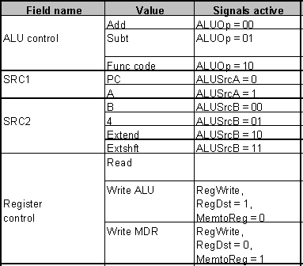
Microinstruction format
(Reg fetch)
A=Reg[IR₂₅₋₂₁], B=Reg[IR₂₀₋₁₆]

Slide 43
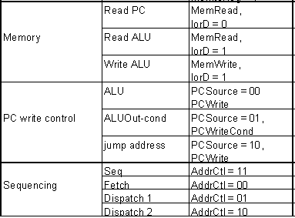
***Microinstruction format

Slide 44
Steps of Instructions

Slide 45
Microprogramming
A specification methodology
appropriate if hundreds of opcodes, modes, cycles, etc.
signals specified symbolically using microinstructions
address
0000
0001
0010
0011
0100
0101
0110
0111
1000
1001

Slide 47
微指令编码
ALU | 0 | 0 | 0 | 0 | 0 | 0 | 1 | 0 | 0 | 0 | ALUOp1
 | 0 | 0 | 0 | 0 | 0 | 0 | 0 | 0 | 1 | 0 | ALUOp0
SRC1 | 0 | 0 | 1 | 0 | 0 | 0 | 1 | 0 | 1 | 0 | ALUSrcA
SRC2 | 0 | 1 | 1 | 0 | 0 | 0 | 0 | 0 | 0 | 0 | ALUSrcB1
 | 1 | 1 | 0 | 0 | 0 | 0 | 0 | 0 | 0 | 0 | ALUSrcB0
Register control | 1 | 0 | 0 | 0 | 0 | 0 | 0 | 0 | 0 | 0 | IRWrite
 | 0 | 0 | 0 | 0 | 1 | 0 | 0 | 1 | 0 | 0 | RegWrite
 | 0 | 0 | 0 | 0 | 0 | 0 | 0 | 1 | 0 | 0 | RegDst
 | 0 | 0 | 0 | 0 | 1 | 0 | 0 | 0 | 0 | 0 | MemtoReg
Memory control | 1 | 0 | 0 | 1 | 0 | 0 | 0 | 0 | 0 | 0 | MemRead
 | 0 | 0 | 0 | 0 | 0 | 1 | 0 | 0 | 0 | 0 | MemRead
 | 0 | 0 | 0 | 1 | 0 | 1 | 0 | 0 | 0 | 0 | IorD
PCWite | 0 | 0 | 0 | 0 | 0 | 0 | 0 | 0 | 0 | 1 | PCSource1
 | 0 | 0 | 0 | 0 | 0 | 0 | 0 | 0 | 1 | 0 | PCSource0
 | 1 | 0 | 0 | 0 | 0 | 0 | 0 | 0 | 0 | 1 | PCWrite
 | 0 | 0 | 0 | 0 | 0 | 0 | 0 | 0 | 1 | 0 | PCWriteCond
Seq | 1 | 0 | 1 | 1 | 0 | 0 | 1 | 0 | 0 | 0 | Addrctl1
 | 1 | 1 | 0 | 1 | 0 | 0 | 1 | 0 | 0 | 0 | Addrctl0
ALU
Register
PCWrite
Label
control
SRC1
SRC2
control
Memory
control
Sequencing
Fetch
Add
PC
4
Read PC
ALU
Seq
Add
PC
Extshft
Read
Dispatch 1
Mem1
Add
A
Extend
Dispatch 2
LW2
Read ALU
Seq
Write MDR
Fetch
SW2
Write ALU
Fetch
Rformat1
Func code
A
B
Seq
Write ALU
Fetch
BEQ1
Subt
A
B
ALUOut-cond
Fetch
JUMP1
Jump address
Fetch

Slide 48
Microprogramming
What are the Microinstructions?

Slide 49
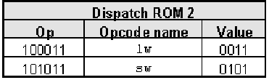
Details
见3rd光盘或2nd的正文

Slide 50
ALU | 0 | 0 | 0 | 0 | 0 | 0 | 1 | 0 | 0 | 0 | ALUOp1
 | 0 | 0 | 0 | 0 | 0 | 0 | 0 | 0 | 1 | 0 | ALUOp0
SRC1 | 0 | 0 | 1 | 0 | 0 | 0 | 1 | 0 | 1 | 0 | ALUSrcA
SRC2 | 0 | 1 | 1 | 0 | 0 | 0 | 0 | 0 | 0 | 0 | ALUSrcB1
 | 1 | 1 | 0 | 0 | 0 | 0 | 0 | 0 | 0 | 0 | ALUSrcB0
Register control | 1 | 0 | 0 | 0 | 0 | 0 | 0 | 0 | 0 | 0 | IRWrite
 | 0 | 0 | 0 | 0 | 1 | 0 | 0 | 1 | 0 | 0 | RegWrite
 | 0 | 0 | 0 | 0 | 0 | 0 | 0 | 1 | 0 | 0 | RegDst
 | 0 | 0 | 0 | 0 | 1 | 0 | 0 | 0 | 0 | 0 | MemtoReg
Memory control | 1 | 0 | 0 | 1 | 0 | 0 | 0 | 0 | 0 | 0 | MemRead
 | 0 | 0 | 0 | 0 | 0 | 1 | 0 | 0 | 0 | 0 | MemRead
 | 0 | 0 | 0 | 1 | 0 | 1 | 0 | 0 | 0 | 0 | IorD
PCWite | 0 | 0 | 0 | 0 | 0 | 0 | 0 | 0 | 0 | 1 | PCSource1
 | 0 | 0 | 0 | 0 | 0 | 0 | 0 | 0 | 1 | 0 | PCSource0
 | 1 | 0 | 0 | 0 | 0 | 0 | 0 | 0 | 0 | 1 | PCWrite
 | 0 | 0 | 0 | 0 | 0 | 0 | 0 | 0 | 1 | 0 | PCWriteCond
Seq | 1 | 0 | 1 | 1 | 0 | 0 | 1 | 0 | 0 | 0 | Addrctl1
 | 1 | 1 | 0 | 1 | 0 | 0 | 1 | 0 | 0 | 0 | Addrctl0
1
Lw
sw
0011
0101
3 2 1 0
State (MC)
Opcode
0
0110
1001
1001
0010
R
J
Beq
Lw
sw

Slide 51
微程序
现代X86不完全是CISC处理器
在前端使用解码器将x86指令翻译成类似RISC指令的微指令送入后端执行
支持流水线与超标量

Slide 52
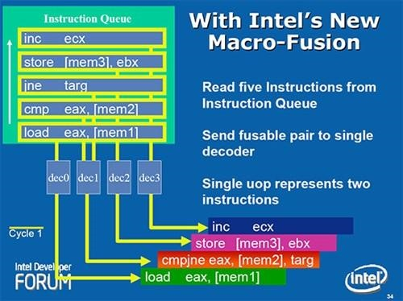
宏融合（Macro-fusion或Macro-ops fusion）
功能
将在程序中经常连续出现的若干条x86指令在解码前融合成一条，从而提高了解码器的效率；
融合后的多条x86指令可以被解码成一条微指令，从而也提高了后端执行的效率。
性能
运行典型的x86程序时，宏融合可以带来约11%的性能提升
英特尔Core、Nehalem和Sandy Bridge微架构和威盛凌珑处理器均支持宏融合，而超微尚不支持这项技术

Slide 53
微融合（micro-fusion）
在解码期间将常用的指令对（如条件分支conditional jump后的比较）融合为单个内部指令（微操作），这样2条程序指令就可以作为1个微操作执行，以减少处理器必须执行的整体工作量，增加了给定时间内可以运行的全部指令数量，或者减少了运行一定指令数量的时间。
Intel Pentium M以后，威盛凌珑处理器

Slide 54
汇编指令集的发展：多媒体、3D扩展
提高电脑在多媒体、3D图形方面的应用能力
MMX
57条多媒体指令
3D NOW!
3D加速指令集
怎么利用这些指令
用专业编译器

Slide 55
汇编指令集标准：SSE Streaming SIMD Extensions
数据拆包（unpack）与随机搬移（shuffle）
包裹式 – SHUFPS, UNPCKHPS, UNPCKLPS
数据型态转换
标量 – CVTSI2SS, CVTSS2SI, CVTTSS2SI
包裹式 – CVTPI2PS, CVTPS2PI, CVTTPS2PI
逐位逻辑运算
包裹式 – ANDPS, ORPS, XORPS, ANDNPS
整数指令
数学运算
PMULHUW, PSADBW, PAVGB, PAVGW, PMAXUB, PMINUB, PMAXSW, PMINSW
数据搬移
PEXTRW, PINSRW
其他
PMOVMSKB, PSHUFW
其他指令
MXCSR 管理
LDMXCSR, STMXCSR
高速缓存与存储器管理
MOVNTQ, MOVNTPS, MASKMOVQ, PREFETCH0, PREFETCH1, PREFETCH2, PREFETCHNTA, SFENCE
英特尔在AMD的3D Now!一年后，MMX的扩充指令集，提供了 70 条新指令。比 MMX 更加常用
Intel Pentium III中的指令集
AMD后来在Athlon XP中加入了对这个新指令集的支持
SSE 指令集
浮点指令
存储器到暂存器／暂存器到存储器／暂存器之间的数据搬移
标量 – MOVSS
包裹式 – MOVAPS, MOVUPS, MOVLPS, MOVHPS, MOVLHPS, MOVHLPS
数学运算
标量 – ADDSS, SUBSS, MULSS, DIVSS, RCPSS, SQRTSS, MAXSS, MINSS, RSQRTSS
包裹式 – ADDPS, SUBPS, MULPS, DIVPS, RCPPS, SQRTPS, MAXPS, MINPS, RSQRTPS
比较
标量 – CMPSS, COMISS, UCOMISS
包裹式 – CMPPS

Slide 56
SSE2
添加了对64位双精度浮点数的支持，以及对整型数据的支持
这个指令集中所有的MMX指令都是多余的，至此MMX成为历史
Intel Pentium 4处理器
AMD Opteron 和Athlon 64处理器
SSE3
包含寄存器的局部位之间的运算，例如高位和低位之间的加减运算；浮点数到整数的转换，以及对超线程技术的支持。
Intel Pentium 4处理器 Prescott 核心
AMD Athlon 64第五个版本，Venice核心
SSSE3
对SSE3指令集的一次额外扩充
Intel Core 2 Duo
SSE4
新增的47条新多媒体指令集，更新至SSE4.2
Intel Penryn核心的Core 2 Duo与Core 2 Solo处理器
SSE4A
AMD 属于自己的SSE4a多媒体指令集
内置在Phenom与Opteron等K10架构处理器中
不与Intel的SSE4系列指令集兼容。

Slide 57
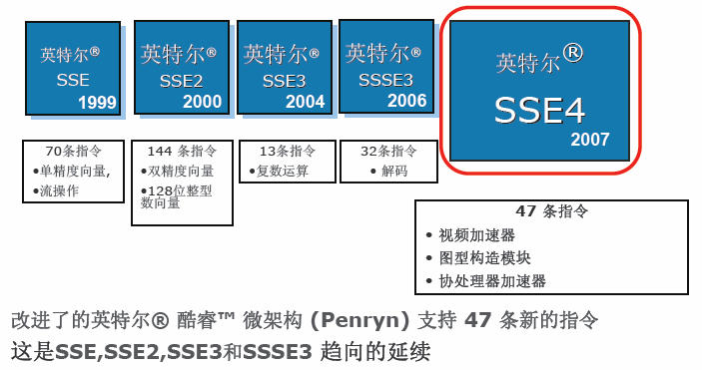

Slide 58
2009年SSE4.2
4.1包括47条指令，4.2包括7条指令。
4.2增加两类汇编：STTNI(STring & Text New Instructions)和ATA(Application Targeted Accelerators)
加速XML文本的字符串操作、存储校验
XML的解析速度最高是原来的3.8倍。
这就是为什么，office2007采用XML，运行在新的处理器上速度更快

Slide 59
SSE5
AMD为了打破Intel垄断在处理器指令集的独霸地位所提出的
初期规划将加入超过100条新指令
三运算对象指令（3-Operand Instructions）
三运算对象指令让处理器可将一个数学或逻辑库，套用到运算对象或输入数据。借由增加运算对象的数量，一个 x86 指令能处理二至三笔数据， SSE5 允许将多个简单指令汇整成一个指令，达到更有效率的指令处理模式。提升为三运算指令的运算能力，是少数 RISC 架构的水平。
熔合乘法累积（Fused Multiply Accumulate）
熔合乘法累积让允许创建新的指令，有效率地运行各种复杂的运算。熔合乘法累积可结合乘法与加法运算，通过单一指令运行多笔重复计算。通过简化代码，让系统能迅速运行绘图着色、快速相片着色、音场音效，以及复杂矢量演算等效能密集的应用作业。
AMD宣布放弃SSE5，转支持intel的AVX
AVX
AVX(Advanced Vector Extensions) 是Intel的SSE延伸架构
把暂存器XMM 128bit提升至YMM 256bit，以增加一倍的运算效率
支持了三运算指令（3-Operand Instructions），减少在编码上需要先复制才能运算的动作。在微码部分使用了LES LDS这两少用的指令作为延伸指令Prefix。
sandy bridge（沙桥）处理器
FMA
FMA是Intel的AVX扩充指令集，如名称上熔合乘法累积（Fused Multiply Accumulate）的意思一样。

Slide 60
Chapter 5: The processor
5.1 Introduction
5.2 Logic Design Conventions
5.3 Building a datapath
5.4 A Simple Implementation Scheme
5.5 Multicycle Approach(3rd version)
5.7 microprogramming: simplifying control design(3rd version,只有1段落7行)
5.7 microprogramming: simplifying control design(2nd version)
5.6 Exceptions

Slide 61
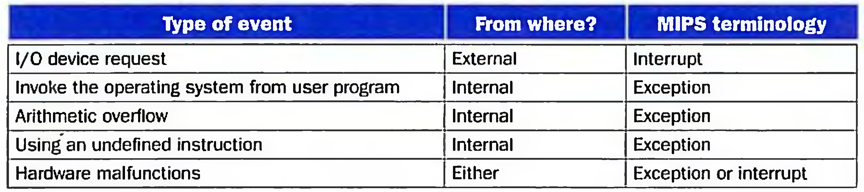
5.6 Exception
The cause of changing CPU’s work flow :
Control instructions in program (bne/beq, j, jal, jr etc)
It is foreseeable in programming flow
Something happen suddenly (Exception and Interruption)
It is unpredictable
Unexpected events
Exception: from within processor ( overflow, undefined instruction, …)
Interruption : from outside processor ( input /output )

Slide 62
5.6 Exception
Exception
An Exception is a unexpected event from within processor.
We follow the MIPS convention, using the term exception to refer to any unexpected change in control flow.
Here we will discuss two types exceptions :
arithmetic overflow
undefined instruction

Slide 63
How Exceptions Are Handled
When exception happens, the processor must do something.
The predefined process routines are saved in memory when computer starts.
Problem: how can CPU goto relative routine when an exception occurs ?
CPU should know
the cause of exception
which instruction generate the exception

Slide 64
How exception is handled
Detect exception
record the cause of exception (CauseReg)
save the address of offending instruction (EPC)
Ask OS to do predefined action
transfer control to OS
execute the predefined program in memory (OS)
terminate the program / restart the user program

Slide 65
How Exceptions Are Handled
Design
add a register: exception program counter(EPC)
save the address of the offending instruction
add a status register: cause register( CauseReg)
hold a field that indicates the reason for the exception.
0 undefined instruction
1 overflow
Another method is to use vector interrupts
bit0 =
Exception type
vector address
undefine instr
c0 00 00 00 _{H}
overflow
c0 00 00 20_{H}

Slide 66
How Control Checks for Exceptions
add control signal
CauseWrite for CauseReg
EPCWrite for EPC
EPC = PC - 4 (completed by ALU)
process of control
CauseReg = 0 or 1
EPC = PC - 4
PC <--- address of process routine ( ex. c0000000 )

Slide 67
How Control Checks for Exceptions(3rd version)

Slide 68
How Control Checks for Exceptions
detect exceptions
Undefined instruction
when no next state is defined from state 1 for op value. New state 10 is introduced.
Overflow
Overflow occurs only in R-type instruction. Overflow is provided as an output from the ALU. This signal is used in the modified FSM to specify an additional state 11 for state 7 .

Slide 71
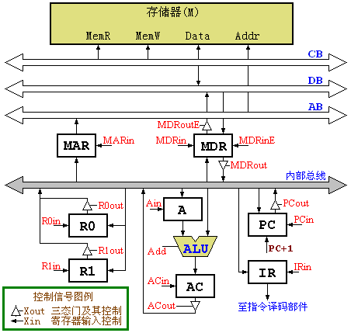
Additional contents
C | Function | Control signals
C1 | MAR←(PC) | PCout, MARin
C2 | MDR←M(MAR) PC←(PC)+1 | MemR, MDRinE PC+1
C3 | IR←(MDR) | MDRout, IRin
C4 | Decoding | none
How to implement the instruction
ADD (R1)，R0 that means:
(R0)+Mem[R1]→ Mem[R1] ?

Slide 72
Key notes
For memory read or write, it is a must to send the address into MAR，any word( instruction or data) read from memory will be send into MDR.
For ALU operation, one operand must be sent into A register first.
Only one data can be transferred through a bus in one clock cycle. A data could not be hop onto the next unit cross any register.
C13: A+ (R0) → AC, R0out, Add, ACin
C14: AC→ (R1), ACout, R1in
C13: A+ (R0) → (R1),
R0out, R1in, Add, ACin, Acout,

Slide 73
Answers
数据流：R1→MAR→MDR(R0→A)→(ALU)AC→MDR→Memory
数据流：R1→MAR→MDR→A (R0)→(ALU)AC→MDR→Memory
R1→MAR→MDR→(ALU)AC→MDR→Memory
(R0→A)
R1→MAR→MDR→A (R0)→(ALU)AC→MDR→Memory
C | Function | Control signals
C5 | MAR←(R1) | Rlout，MARin
C6 | MDR←M(MAR) A←(R0) | MemR，MDRinE R0out，Ain
C7 | AC←(MDR)+(A) | MDRout，Add，ACin
C8 | MDR←(AC) | ACout，MDRin
C9 | M(MAR)←(MDR) | MDRouE，MemW
C | Function | Control signals
C5 | MAR←(R1) | Rlout，MARin
C6 | MDR←M(MAR) | MemR，MDRinE
C7 | A←(MDR) | MDRout，Ain
C8 | AC←(A)+(R0) | R0out，Add，ACin
C9 | MDR ←(AC) | ACout，MDRin
C10 | M(MAR)←(MDR) | MDRoutE，MemW

Slide 74
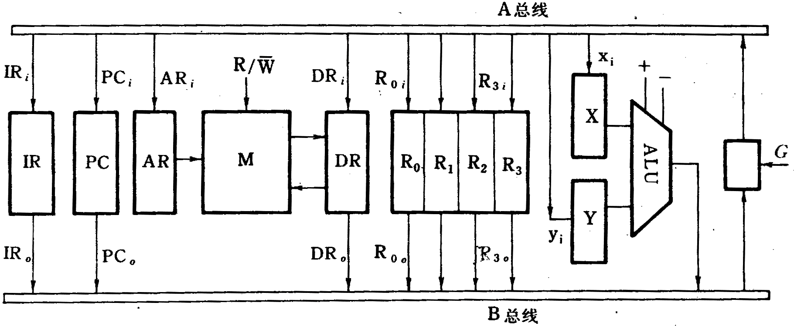
What if using two bus structure ?
How to implement Instruction “ADD R3, R1, R2” ?
( Please ignore PC+4 for the next instruction. )

Slide 75
END

